Slide 1
EE4007 - OPTICAL ELECTRONICS
January 2010
© Alan P. Morrison
Lecture 5 - Integrated optical waveguides

Slide 2
DISPERSION AND DISTORTION IN THE SLAB WAVEGUIDE
January 2010
Pulse spreading present in any dielectric structure containing dispersive material
2 additional sources of distortion in waveguides such as slab waveguide
  waveguide dispersion
  multimode distortion
Waveguide dispersion:
  mode chart shows that effective refractive index for any particular mode varies with wavelength for a fixed film thickness, even if the film and substrate materials are not dispersive - this is waveguide dispersion.
© Alan P. Morrison

Slide 3
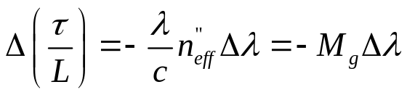
DISPERSION AND DISTORTION IN THE SLAB WAVEGUIDE
January 2010
Variation in n_{eff} causes pulse spreading, just as variations in n.
If the material is also dispersive, then waveguide and material dispersion are present simultaneously
Amount of pulse spreading caused by the waveguide is given by the same equation as that previously developed for material dispersion, with the effective refractive index replacing the material refractive index.
Multimode distortion -
when numerous modes propagate in the slab, they all travel with different net velocities with respect to the waveguide axis.
© Alan P. Morrison

Slide 4
DISPERSION AND DISTORTION IN THE SLAB WAVEGUIDE
January 2010
Input waveform distorts during propagation because its energy is distributed amongst several modes, each travelling at a different speed.
Parts of the waveform arrive before others, resulting in a spreading out of the waveform - this is multimode distortion or modal distortion.
Also does not depend on source linewidth - it is a property only of the waveguide allowing multiple modes to propagate
No modal distortion if waveguide is single-mode
© Alan P. Morrison

Slide 5
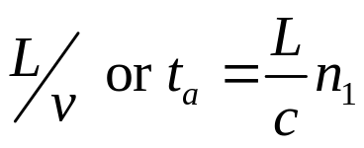
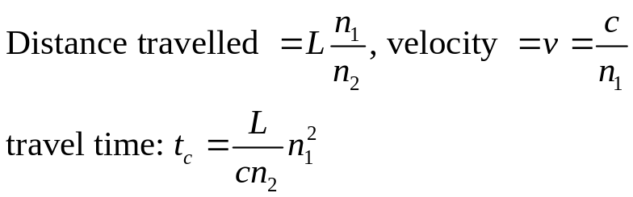
DISPERSION AND DISTORTION IN THE SLAB WAVEGUIDE
January 2010
To calculate the modal distortion for a slab => find travel time difference between mode propagating along axis and one propagating at steepest angle w.r.t. axis (rays at critical angle)
Axial mode will reach end of waveguide first
considering a symmetric waveguide of length L, the axial travel time will be:
critical angle ray will arrive last among many modes, because it travels farthest
© Alan P. Morrison

Slide 6
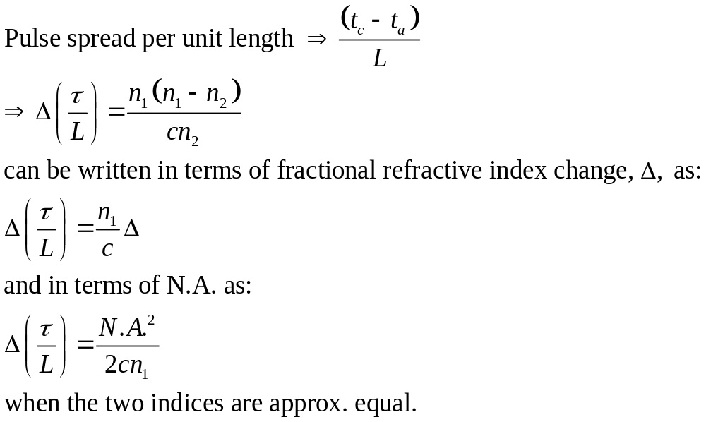
DISPERSION AND DISTORTION IN THE SLAB WAVEGUIDE
January 2010
In a multimode waveguide, material dispersion, waveguide dispersion and modal distortion exist simultaneously - will study these in more detail when talking about fibre optics
© Alan P. Morrison

Slide 7
DISPERSION AND DISTORTION IN THE SLAB WAVEGUIDE
January 2010
Since distortion increases with path length and because integrated optic circuits are normally quite short, distortion is not as much a problem as with fibres
Distortion is more easily described for integrated optic waveguides, than for cylindrical fibres.
© Alan P. Morrison

Slide 8
INTEGRATED OPTICAL COMPONENTS
January 2010
Passive devices:
    directional couplers, beam-splitters, isolators, filters, lenses and prisms
Active devices:
    modulators, switches, light sources, light detectors
Passive devices generally constructed by modifying the waveguide structure. Examples: lens, directional coupler
© Alan P. Morrison

Slide 9
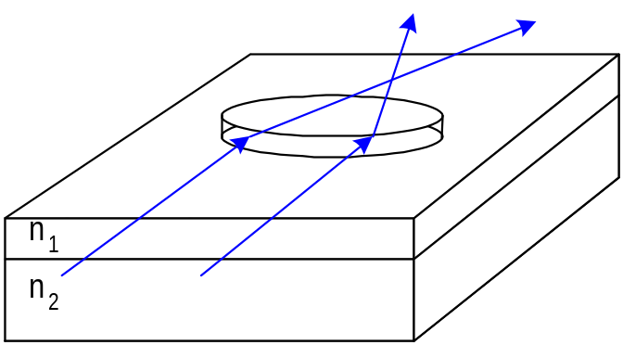
INTEGRATED OPTICAL COMPONENTS
January 2010
Lens - varying thickness of a film will change its refractive index
Directional coupler: % of light coupled into adjacent waveguide varied between 0 and 100 by choosing suitable length of coupling region
Coupling occurs between adjacent waveguides because their evanescent fields overlap
© Alan P. Morrison

Slide 10
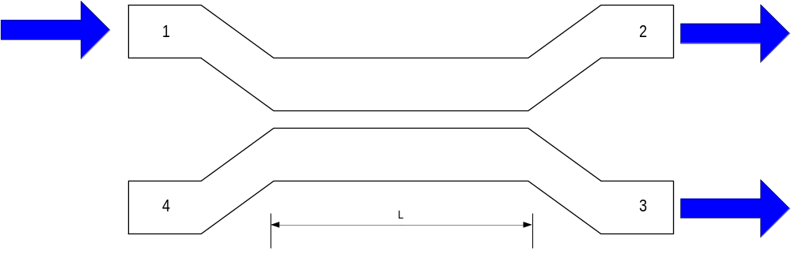
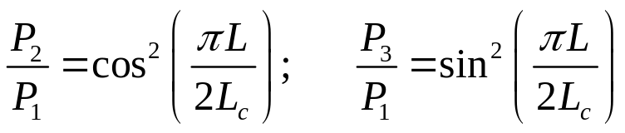
INTEGRATED OPTICAL COMPONENTS
January 2010
for an ideal coupler, relative output powers are given by:
efficient coupling requires that propagation factor be the same for each waveguide - easily satisfied for identical waveguides
© Alan P. Morrison
L_{c} = length over which there
is complete transfer from upper to
lower waveguide.

Slide 11
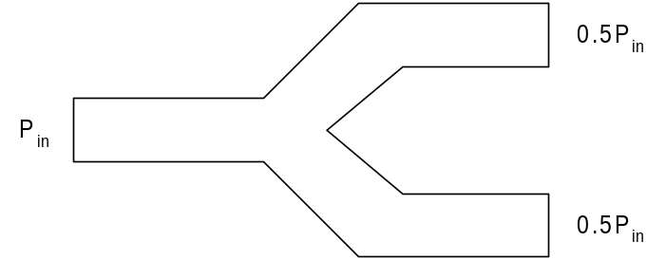
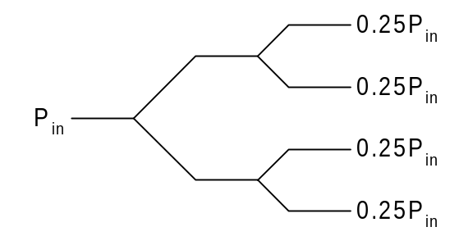
INTEGRATED OPTICAL COMPONENTS
January 2010
Directional couplers are described in terms of the amount of power, in dB, coupled to the adjacent waveguide
Waveguide pattern for integrated optic power splitter
more output ports accommodated by serially connecting several Y-branches
© Alan P. Morrison

Slide 12
INTEGRATED OPTICAL COMPONENTS
January 2010
Active devices:
2 categories - (i) control light, (ii) convert light
Category (i) includes devices for beam switching, deflection, scanning and light modulation
Category (ii) includes sources (convert electricity to light) and photodetectors (convert light to electricity)
Active control devices depend on materials with electro-optic (change refractive index with applied electric field) or acousto-optic (interaction between piezoelectrically excited acoustic wave on the surface of the waveguide and the light beam) properties.
© Alan P. Morrison

Slide 13
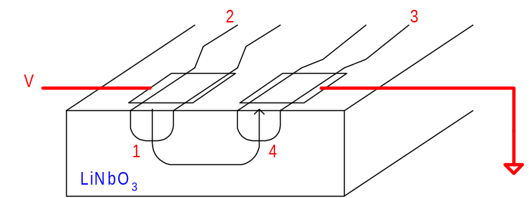
INTEGRATED OPTICAL COMPONENTS
January 2010
Electro-optic switch:
film must have strong E-O effect, LiNbO₃ is suitable material
similar to directional coupler, designed so all light is coupled to second waveguide when no bias applied
apply voltage => electric fields cause refractive indices to change
different refractive indices => no phase matching => cross-coupling reduced to zero
switch can also operate as a modulator - intensity of light in either channel controlled by applied bias.
© Alan P. Morrison

Slide 14
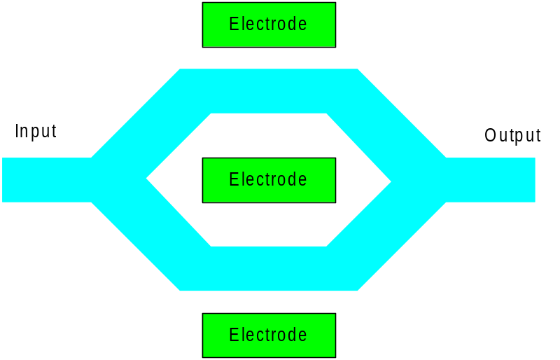
INTEGRATED OPTICAL COMPONENTS
January 2010
Mach-Zehnder interferometer as a modulator
parallel Ti diffused waveguides on LiNbO₃ substrate
incoming beam split evenly along two paths and recombined at output
no voltage => two beams recombine in phase at output and maximum transmission occurs (constructive interference)
applying a suitable voltage => 180º phase shift can be obtained => destructive interference. Can operate in GHz range.
© Alan P. Morrison

Slide 15
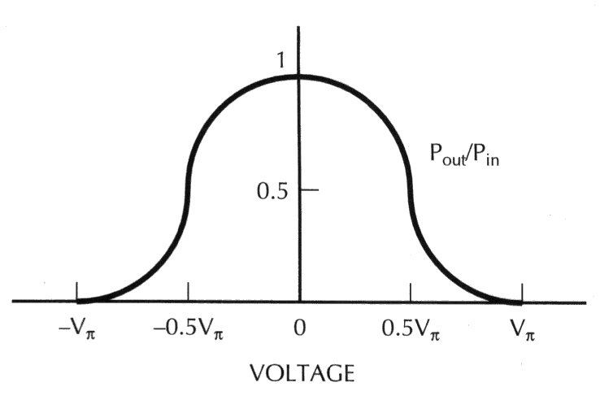
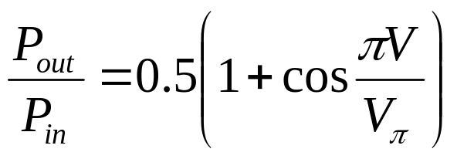
INTEGRATED OPTICAL COMPONENTS
January 2010
Transfer characteristic of modulator used as switch
© Alan P. Morrison
V_{π} = half-wave voltage i.e. voltage that produces 180º phase shift

Slide 16
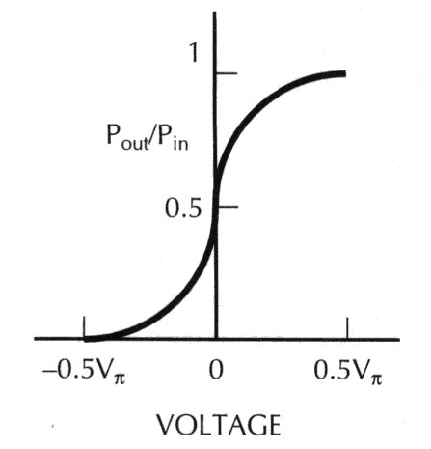
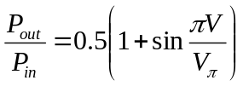
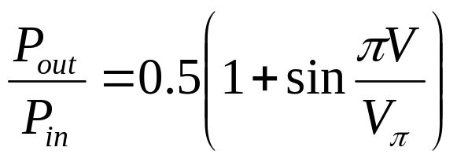
INTEGRATED OPTICAL COMPONENTS
January 2010
modulator transfer characteristic:
© Alan P. Morrison
modulators and switches external to the source are important for several reasons:

Slide 17
INTEGRATED OPTICAL COMPONENTS
January 2010
External modulation can be achieved at higher frequencies than can be obtained by direct modulation of LEDs and LDs
Also direct modulation of a LD can change its output λ and linewidth, external modulation does not
In some applications these changes are undesirable e.g. optical multiplexing of closely spaced channels, or operation at wavelength of minimum material dispersion
Optoelectronic Integrated Circuits (OEIC) combine optical and electronic functions on the same substrate.
These are constructed using semiconductor substrates and films
OEICs are sometimes referred to as photonic integrated circuits
© Alan P. Morrison

